Slide 1
A
PROJECT REPORT
ON
FREELANCER MANAGEMENT SYSTEM (CODEWORK)
Submitted to:
Department of Computer Application (MCA), Visnagar
Affiliated to:
Sankalchand Patel University
Submitted by:
STUDENT NAME PRN NO.
1. Krunal Bhavsar 201609590000807
2. Gaurang Parmar 201609590000684

Slide 2
PROJECT PROFILE
PROJECT NAME | CODEWORK FREELANCER MANAGEMENT SYSTEM
OBJECTIVE | We provide information about freelancers and freelancing services
FRONT END TOOL | PHP 7.4.1
BACK END TOOL | MySQL 5.0
SYSTEM SOFTWARE | Windows 10
DOCUMENTATION | MS Office 2019
OTHER TOOL | Dreamweaver CC, Visual Studio Code
DEVELOPED BY | Krunal Bhavsar Gaurang Parmar

Slide 3
DRAWBACK OF EXISTING SYSTEM
The current website takes more money as commotions.
In existing system, mostly website focus on clients because they spends money, but there are less facilities for freelancer like it is not easy to find first project for freelancer but clients get there freelancer very easily.

Slide 4
NEED FOR NEW SYSTEM
Various freelancer can be found for different type of website development and designing work.
Client can post project and choose a best freelancer from all of list.
Browse freelancer profiles, compare proposals and select the best one, award your project and your freelancer goes to work.
Pay when you are satisfied!
Codework has no access fees, subscriptions, monthly fees or annual fees. There are no fees to post a project or set up a user account. Employer commissions and upgrade fees are also waived for volume customers.
Freelancers get there first project easily according to their experience and level of learned skills.

Slide 5
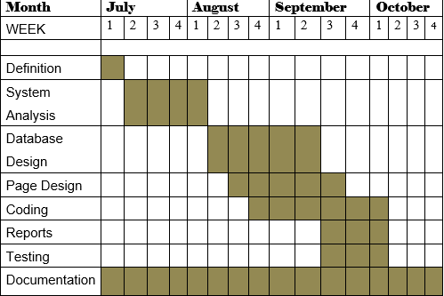
Timeline Chart

Slide 6
HARDWARE TOOLS (Min-for client and server both)
PROCESSOR : Intel Dual Core
RAM : 2GB
HARD-DISK : 320GB
WINDOWS : WINDOWS XP or later

Slide 7
SOFTWARE TOOLS (Server)
FRONT END TOOL : PHP 7.4
BACK END TOOL : MySQL 5.0
OTHER TOOLS : MS Office 2019
(Clients)
Browser : Any HTML 5 Supported Browser

Slide 8
SYSTEM DESIGN

Slide 9
DATA DICTIONARY
1. users (Admin/Client/Freelancer)
Sr.No | Field Name | Type | Size | Constraints | Description
1 | Id | Int | 11 | Primary Key | User id
2 | Name | Varchar | 30 | Not null | User name
3 | Email | Varchar | 30 | Unique key | User email
4 | password | Varchar | 128 | Not null | User password
5 | Type | Varchar | 10 | Not Null | User Type
5 | lang | Varchar | 10 | Not null | Programming language
6 | Cv | Varchar | 50 | Not null | Path of resume file
7 | Id_proof | Varchar | 50 | Not null | Path of Id/proof file
5 | date | Time stamp | - | Current timestamp | Date Update Records
Description: - Admin login information.

Slide 10
2. feedbacks
Sr.No | Field Name | Type | Size | Constraints | Description
1 | Fbid | int | 11 | Primary key | Feedback id
2 | Name | Varchar | 30 | Not null | user name
3 | Email | Varchar | 50 | Unique key | user email
4 | Msg | Varchar | 255 | Not null | Feedback message
5 | uid | int | 11 | Foreign Key | Users id or can be null if not logged in
6 | Is_read | Tinyint | 1 | Not null | Msg read or not
7 | date | Time stamp | - | Current timestamp | Feedback Date
Description: - user feedback details.

Slide 11
3. projects
Sr.No | Field Name | Type | Size | Constraints | Description
1 | Pid | Int | 11 | Primary key | Project id
2 | Name | Varchar | 30 | Not null | Project name
3 | Detail | Text | - | Not null | Project detail
4 | catagory | Varchar | 30 | Not null | Project catagory
5 | File | varchar | 255 | Not null | Browse project file
4 | Lang | Varchar | 20 | Not null | programming language
5 | cid | Int | 11 | foreign key | Client id
6 | Fid | Int | 11 | foreign key | Freelancer id
7 | Status | Varchar | 20 | Not null | Project status
8 | Cost | Int | 11 | Not null | Project cost
9 | Paid | int | 11 | Not null | Project paid
10 | Date | Time stamp | - | Current timestamp | Project Date
Description: - client post project details.

Slide 12
4. requests
Sr.No | Field Name | Type | Size | Constraints | Description
1 | Rid | Int | 11 | Primary key | Request id
2 | Pid | Int | 11 | foreign key | Project id
3 | Fid | Int | 11 | foreign key | Freelancer id
4 | Msg | Varchar | 255 | Not null | Message
5 | Status | Varchar | 20 | Not null | Project status
6 | Date | Time stamp | - | Current timestamp | Project Request date
Description: - freelancer project request details.

Slide 13
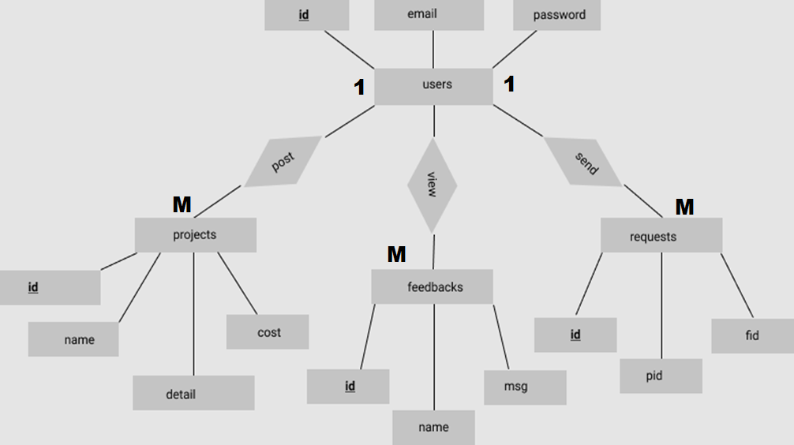
E R DIAGRAM

Slide 14
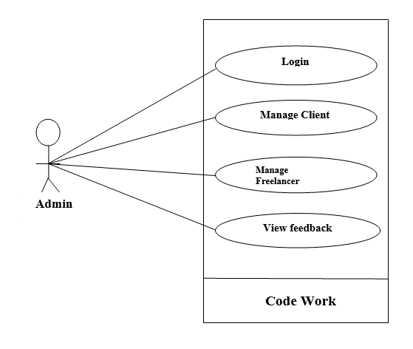
UML Diagram Use case diagram: user-admin

Slide 15
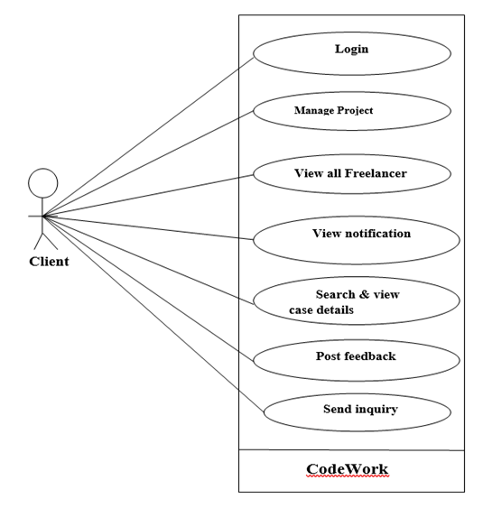
Use case diagram: user-client

Slide 16
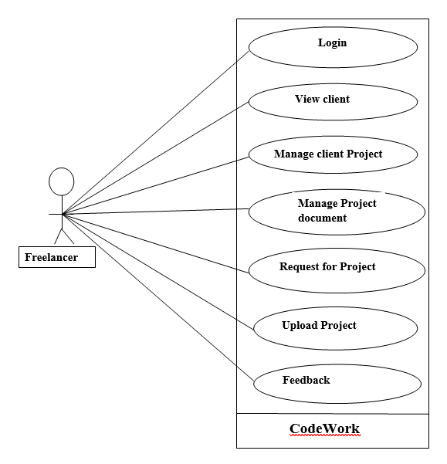
Use case diagram: user-freelancer

Slide 17
1
Users
Id (PK) Name Email Password Date
Add() Edit() Update() Delete()
1
M
M
Feedbacks
Id (PK) Name Email Uid Msg Is_read Date
Add() Edit() Update() Delete()
Requests
Id (PK) cid(FK) Fid(FK) msg status Date
Add() Edit() Update() Delete()
1
M
M
Projects
Id (PK) Name detail Category File cid(FK) Fid(FK) cost Date
Add() Edit() Update() Delete()
M

Slide 18
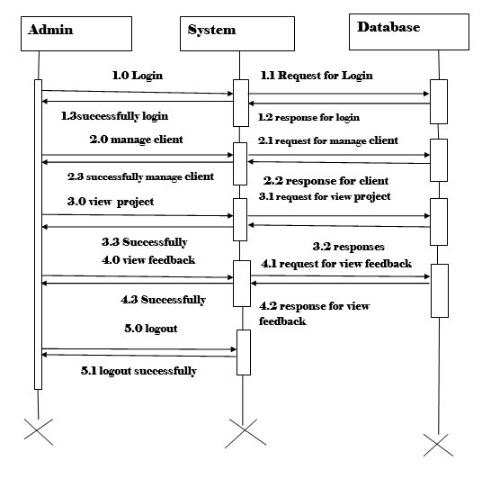
Sequence Diagram: admin

Slide 19
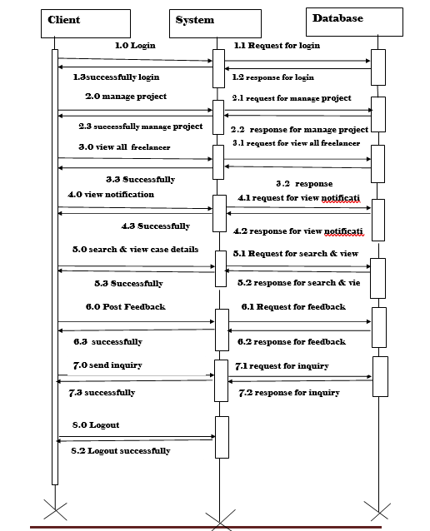
Sequence Diagram: client

Slide 20
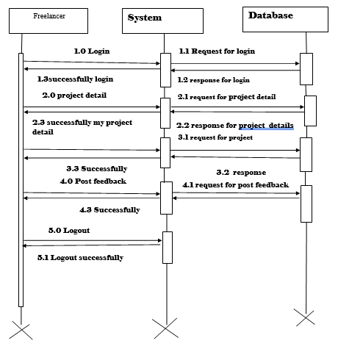
Sequence Diagram: freelancer

Slide 21
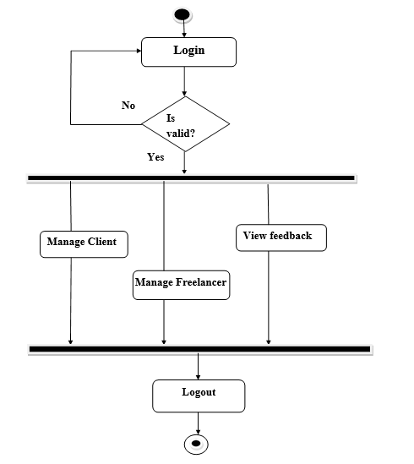
Activity Diagram: admin

Slide 22
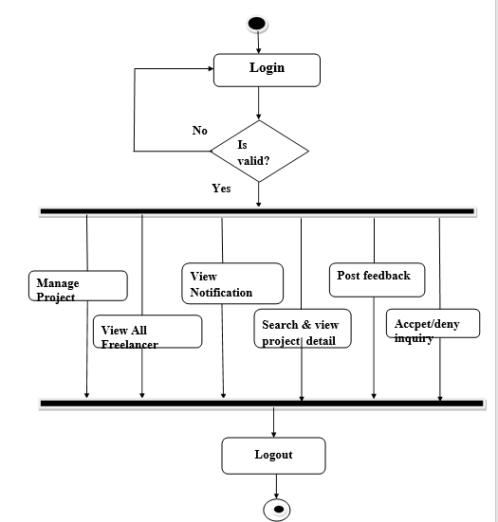
Activity Diagram: client

Slide 23
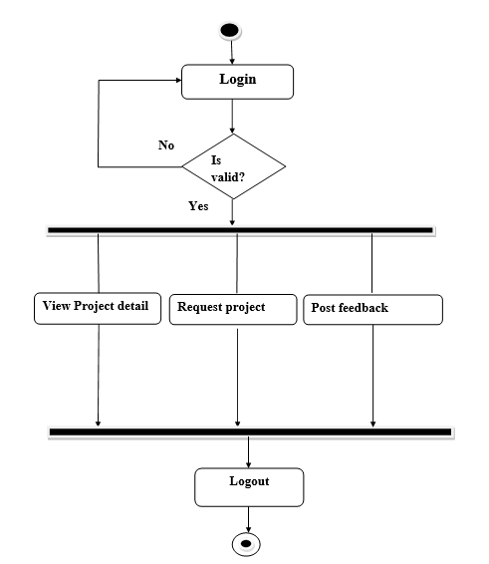
Activity Diagram: freelancer

Slide 24
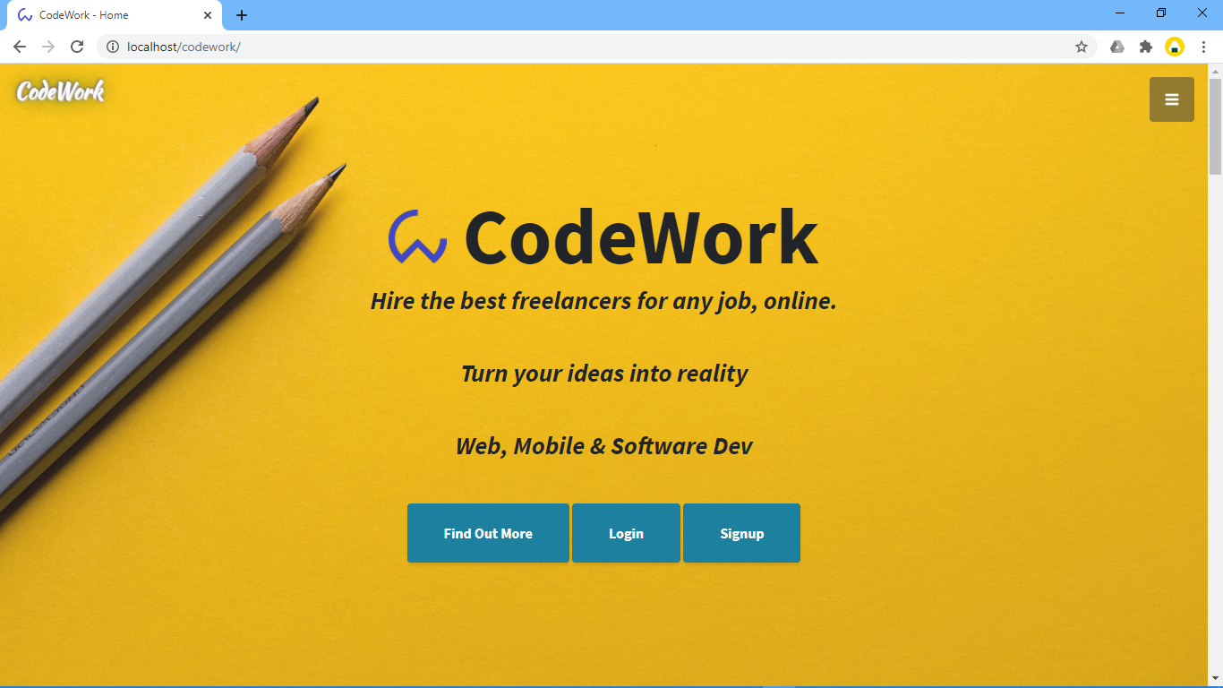
1. Home Page
Description:-This is the Home Page.

Slide 25
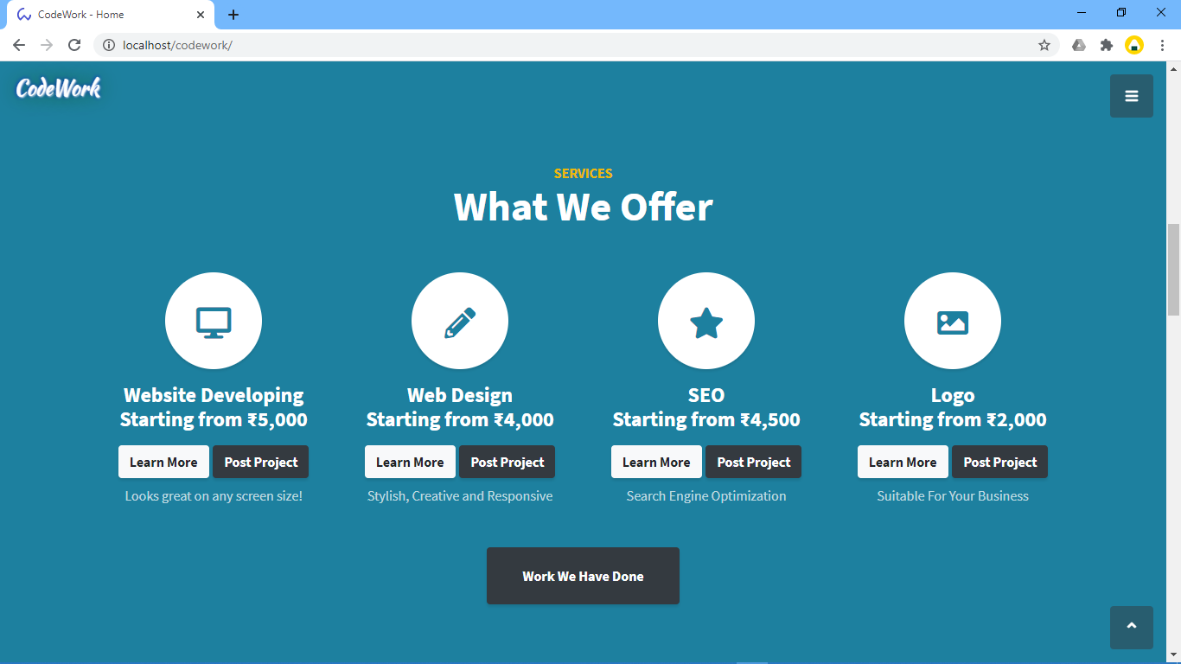
2. Service
Description:-This is the registration page.

Slide 26
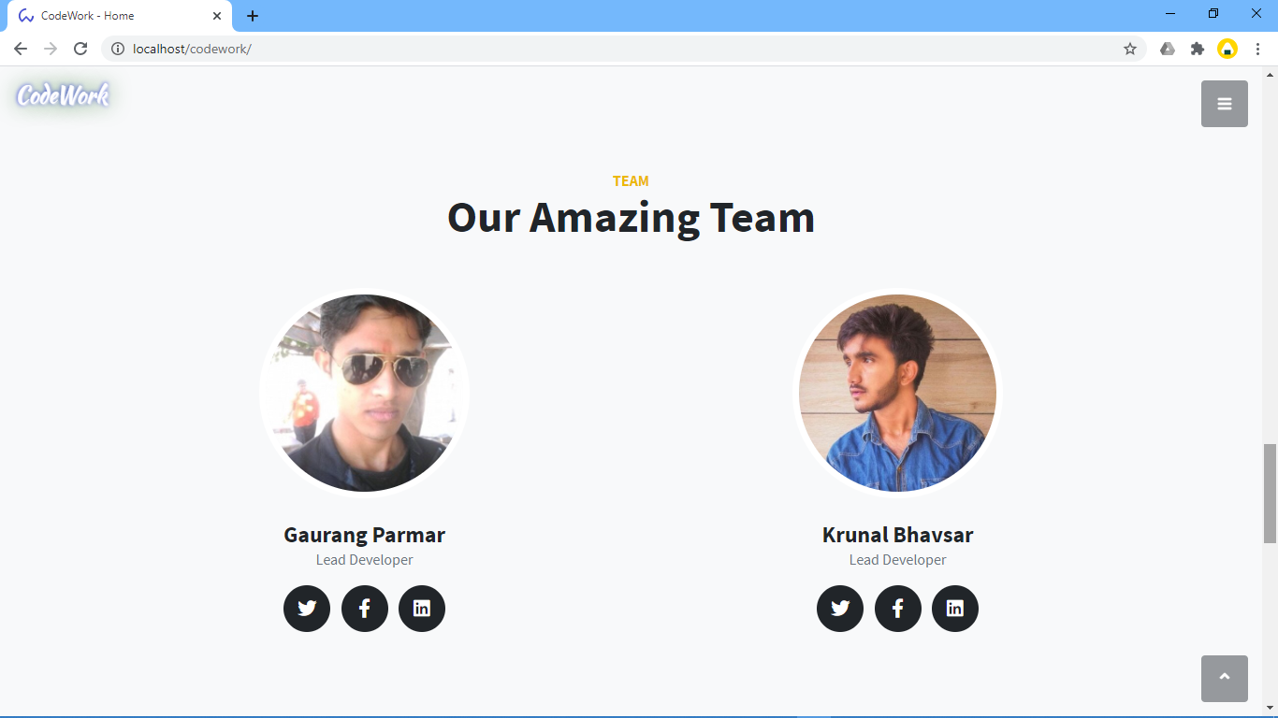
.

Slide 27
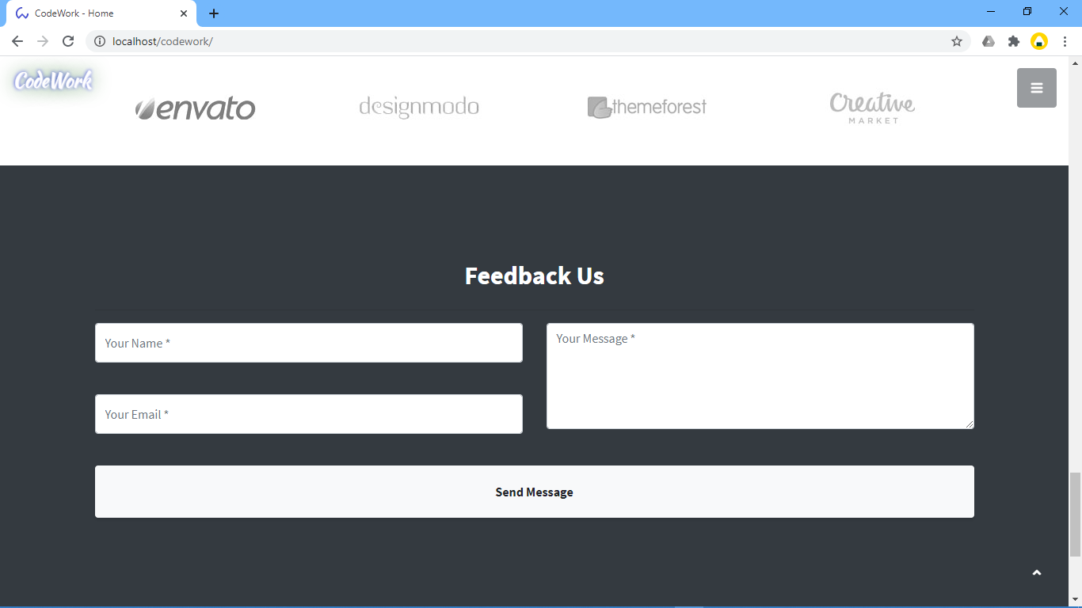
3. Feedback

Slide 28
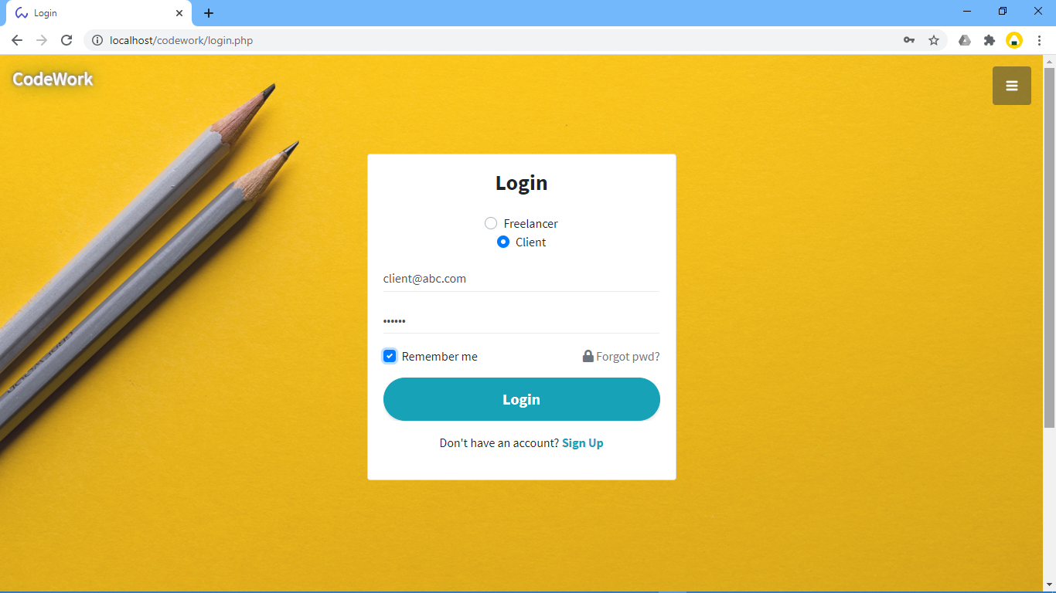
4. User login page: -
Description:-This is admin Login page.

Slide 29
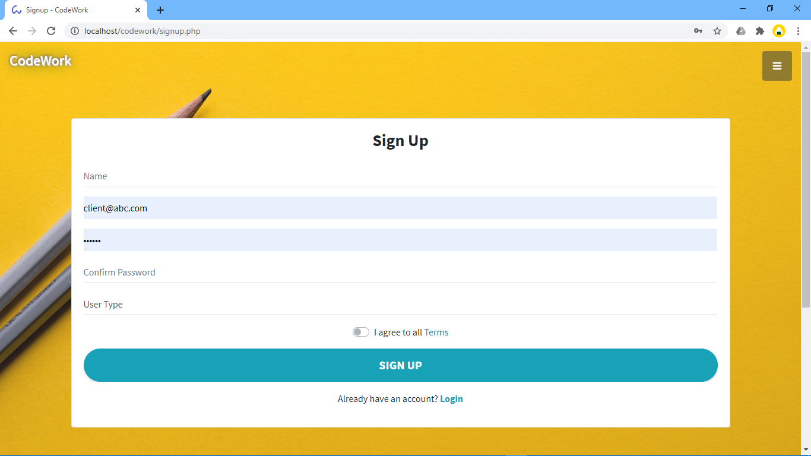
5. User signup page:
Description:-This is Sign Up page

Slide 30
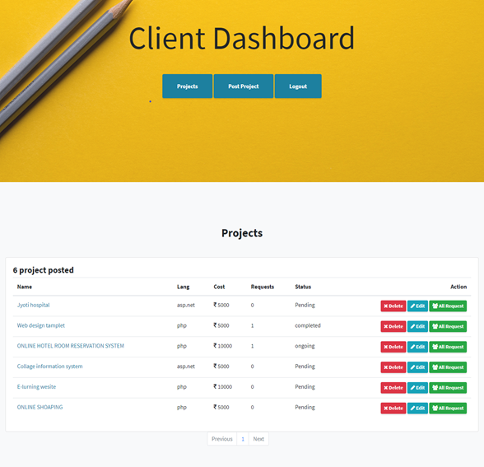
6. Client page:-
Description:-This is editable page for client’s post.

Slide 31
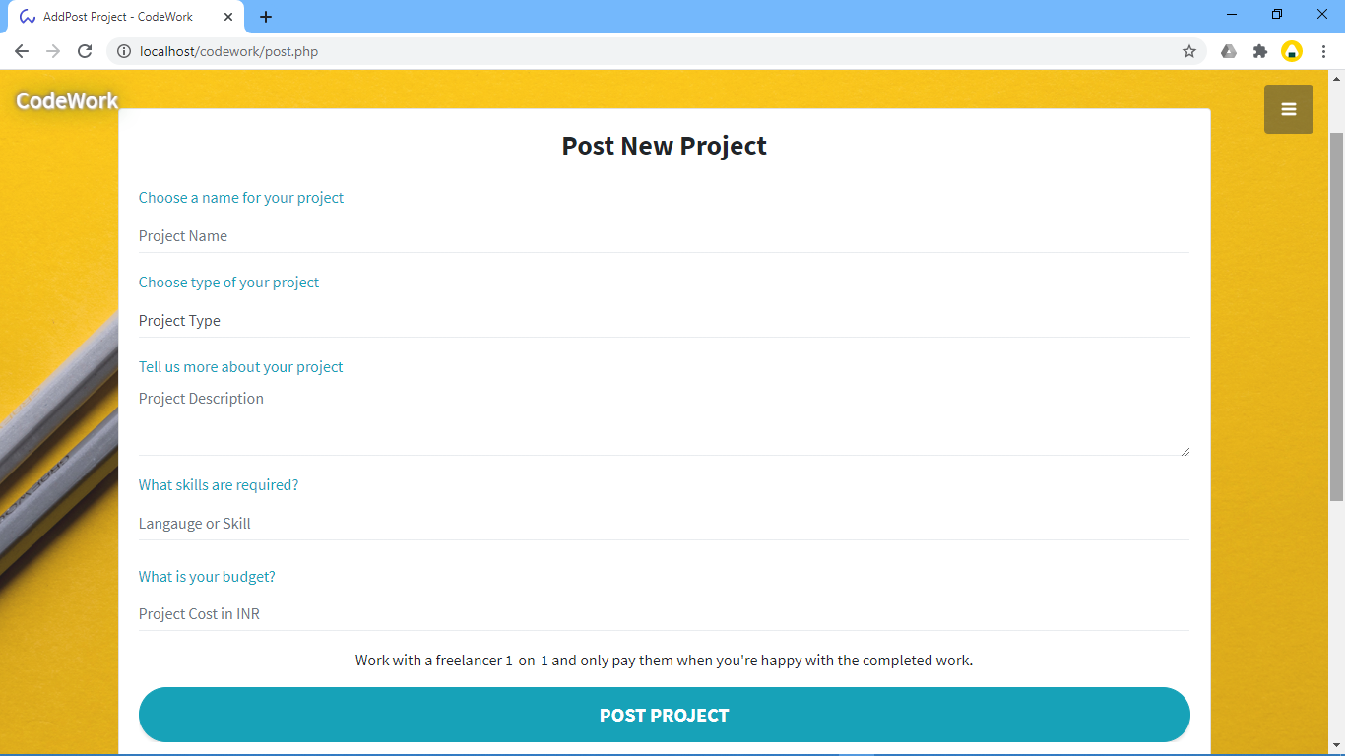
7. Post project form
Description:-This is post project page form

Slide 32
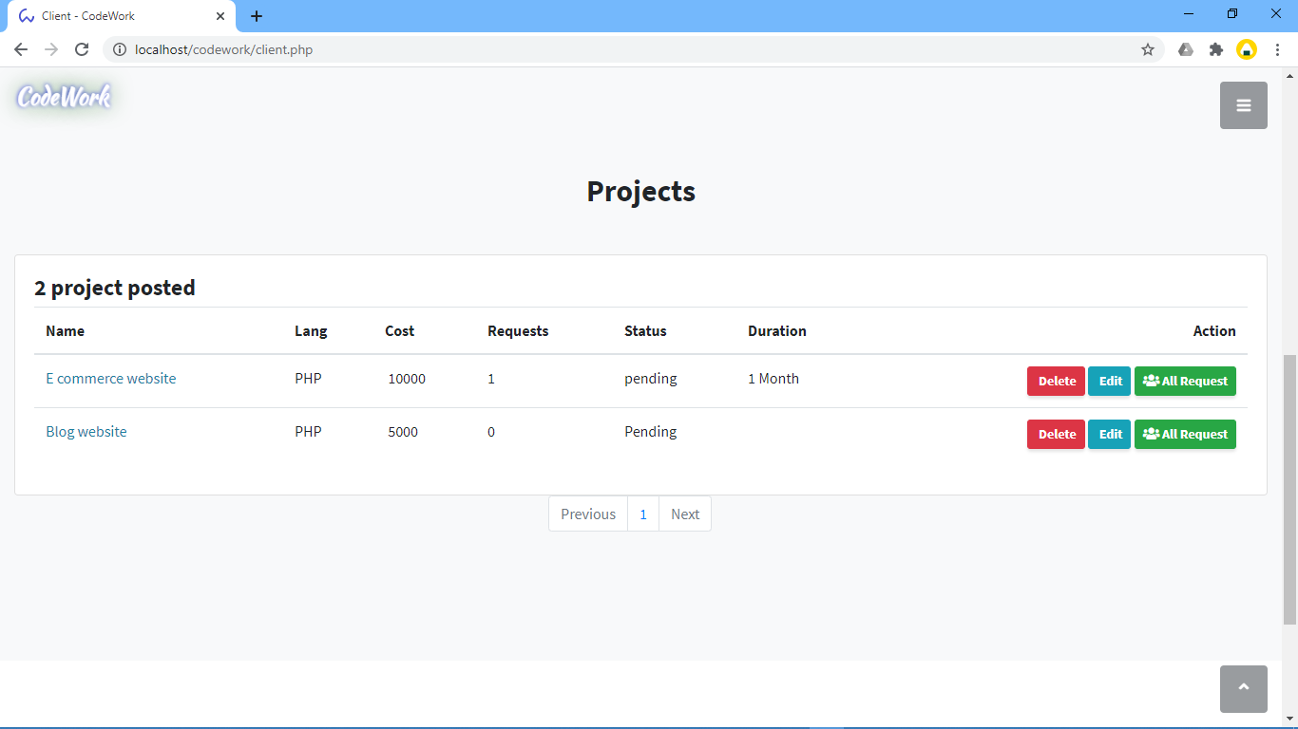
8. Project posted by client:-

Slide 33
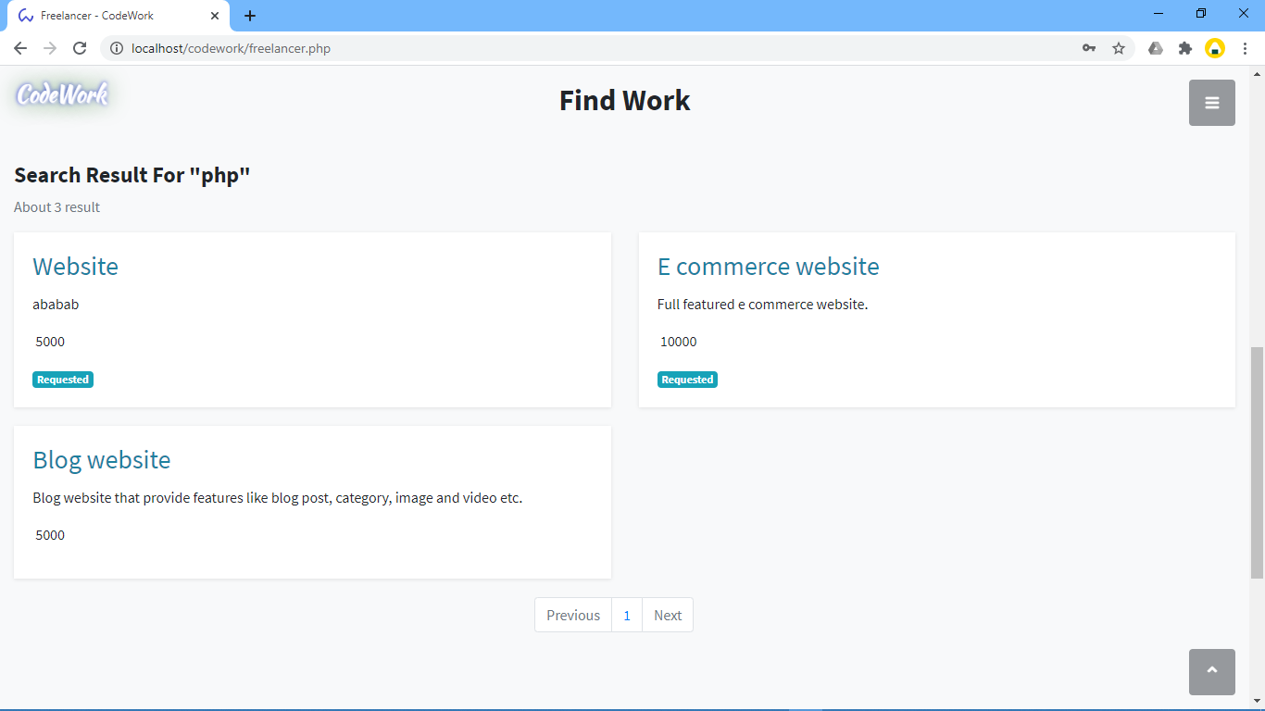
9. Freelancer page: -

Slide 34
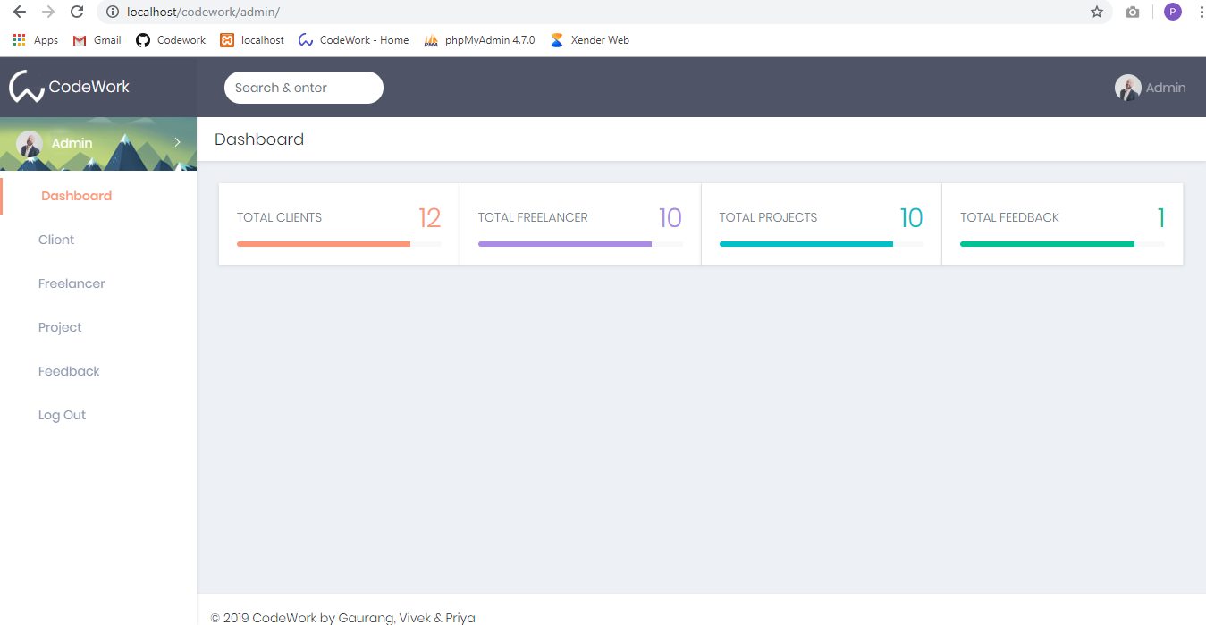
REPORT DESIGN
1. Admin Home Page
Description:-This is login page admin side.

Slide 35
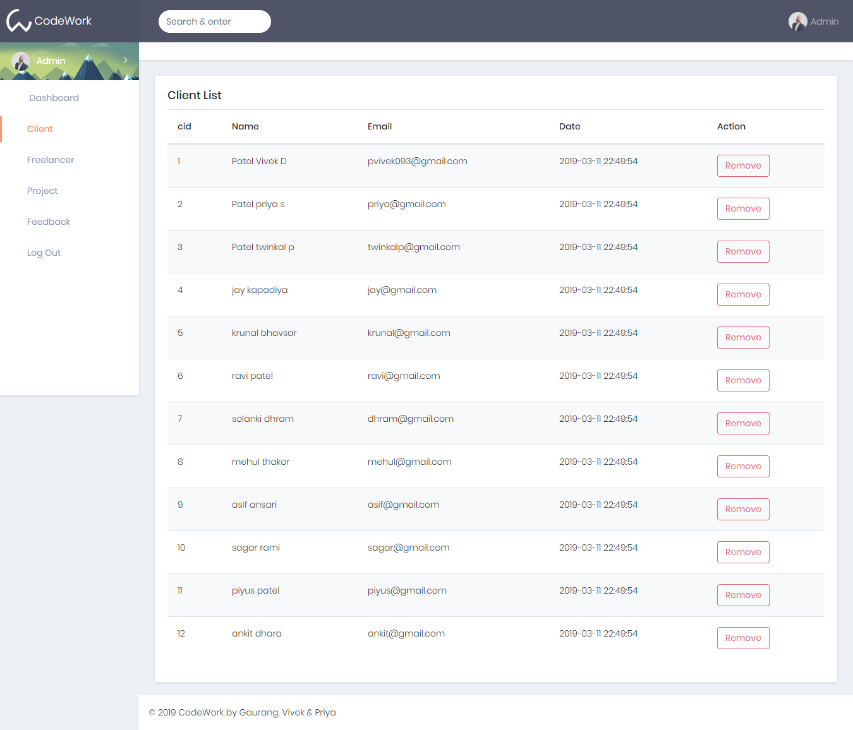
2. Client Report
Description:-This is client report.

Slide 36
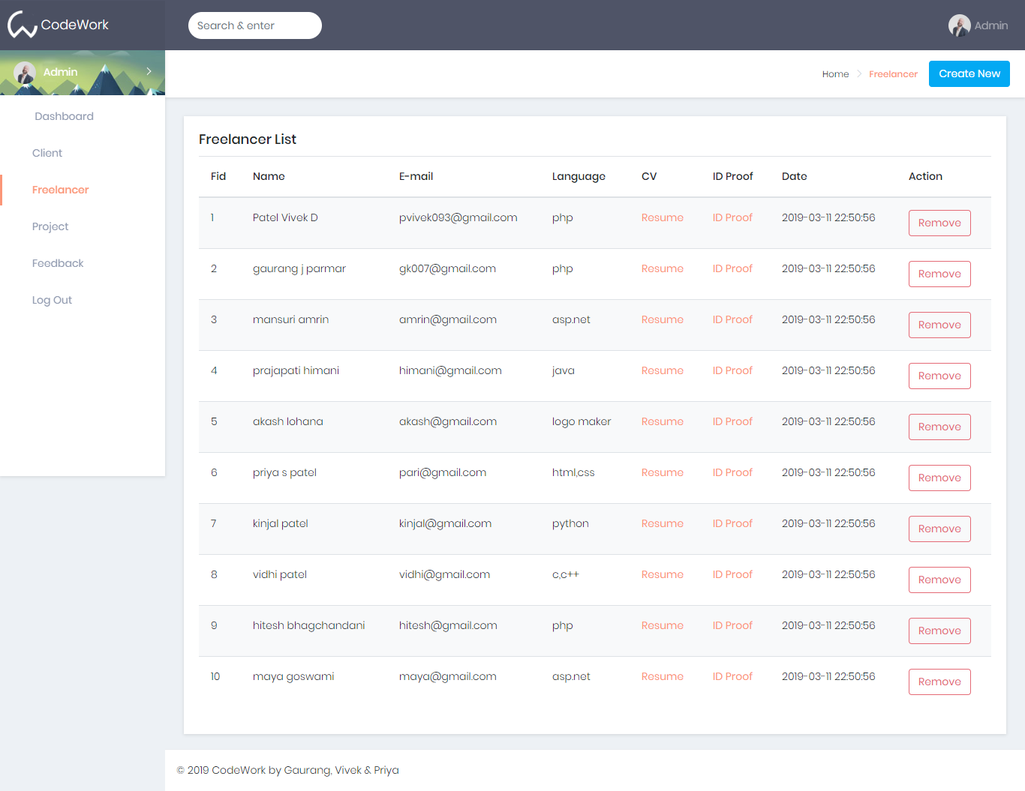
3. Freelancer Report
Description:- This is freelancer report.

Slide 37
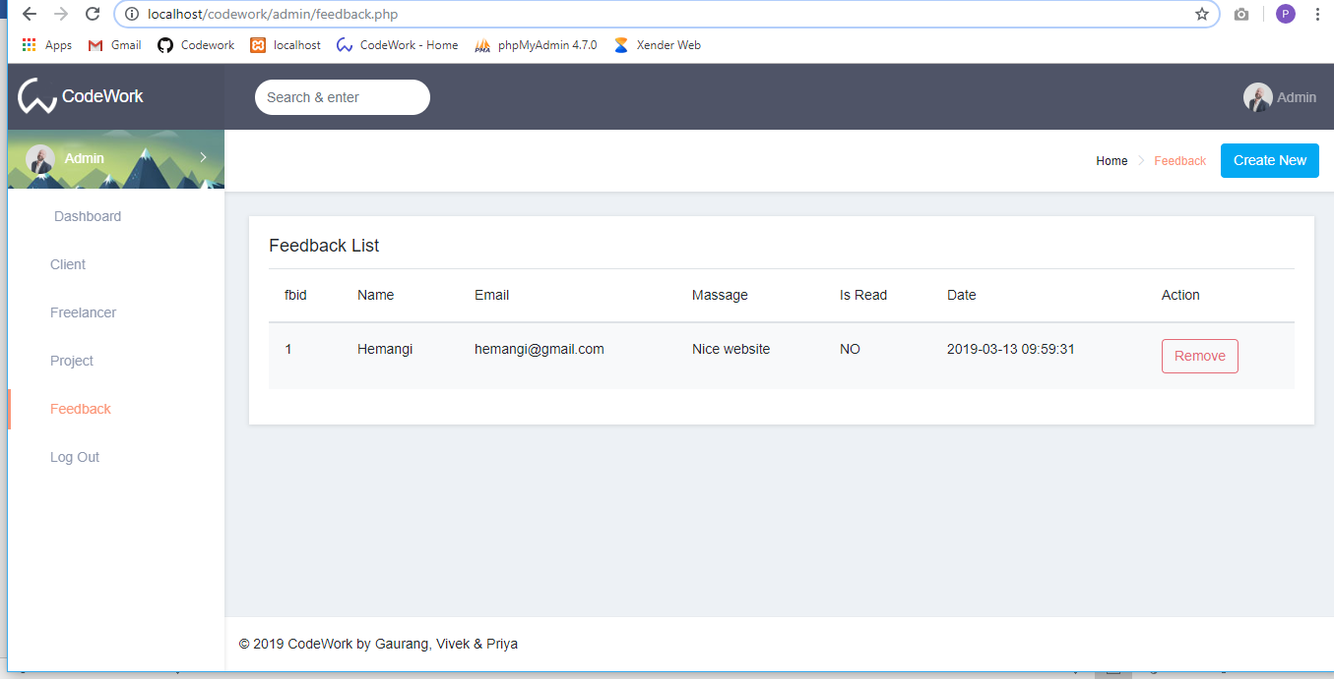
4. Feedback Report
Description:- This page is after login admin side provide information about feedback report.

Slide 38
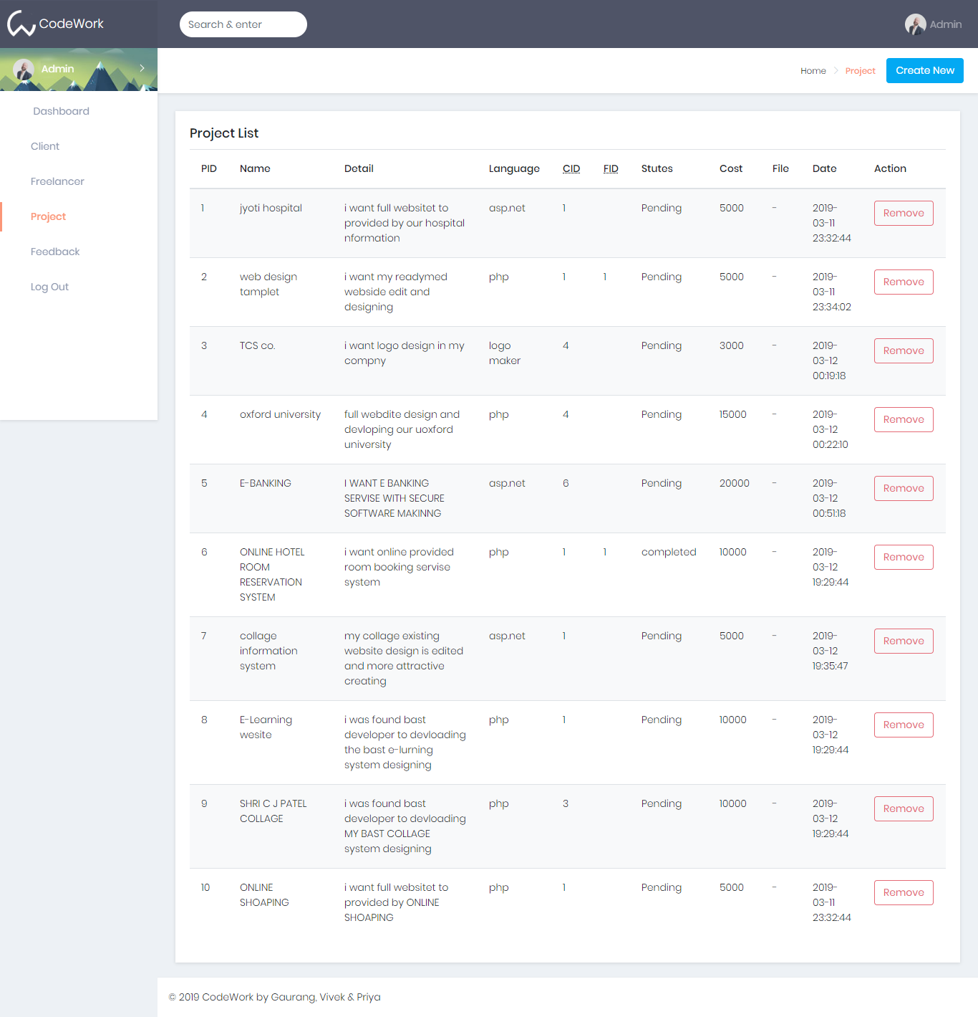
5. Project Report
Description:- This page is after login admin side provide information about project report.

Slide 39
TESTING & RESULT
Testing has a dual function it is used to establish the presence of defects in program and it is used to help judge whether or not the program is usable in practice. Thus, software testing is used for validation and verification, which ensure that software conforms to its specifications and meets the need of the software customer.
We have resorted Alpha testing, which usually comes in after the basic design of the program has been completed. The project scientist will look over the program and the suggestions and ideas to improve or to correct the design. They also report and give ideas to get rid of around any major problems. There is bound to be a number of bugs after a problem have been created.

Slide 40
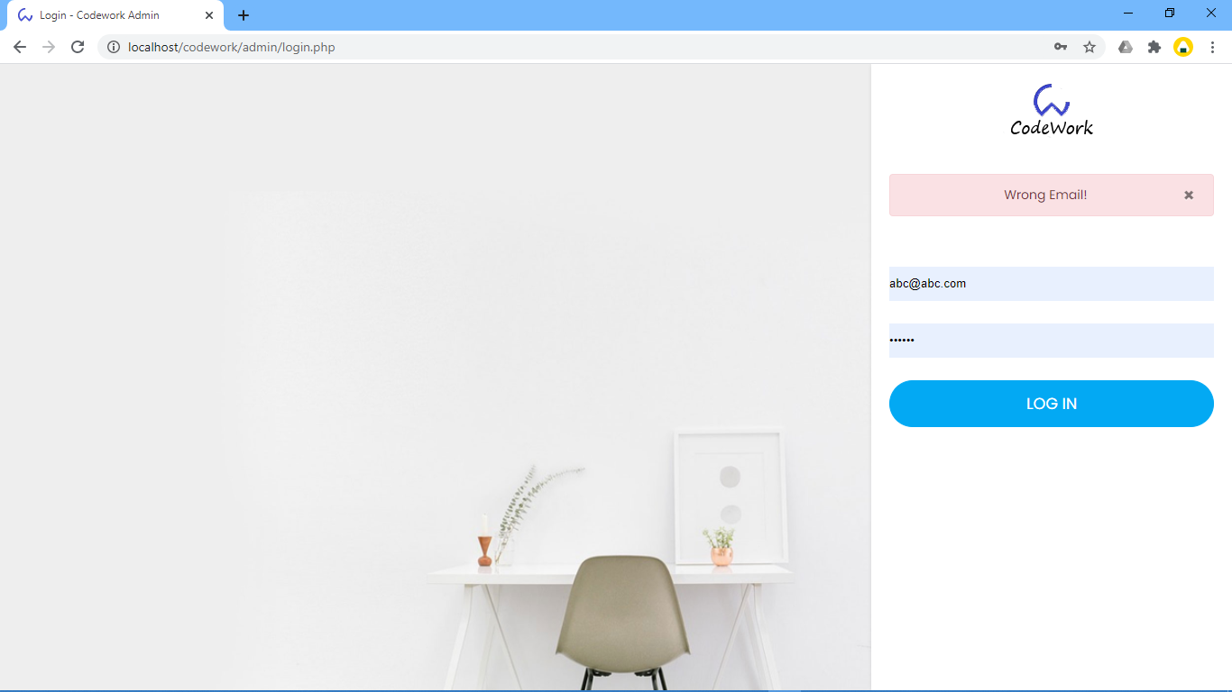
Admin Login Form :-
SI NO. | Test case | Expected Result | Test Result
1 | Enter valid name and password & click on login button | Display main window | Success
2 | Enter invalid name and password & click on login button | Does not display main window and show the error | Success

Slide 41

User login form: -
SI NO. | Test case | Expected Result | Test Result
1 | Enter valid name and password & click on login button | User can add/view/request project. | Success
2 | Enter invalid name and password & click on login button | User can not add/view/request project. | Success

Slide 42
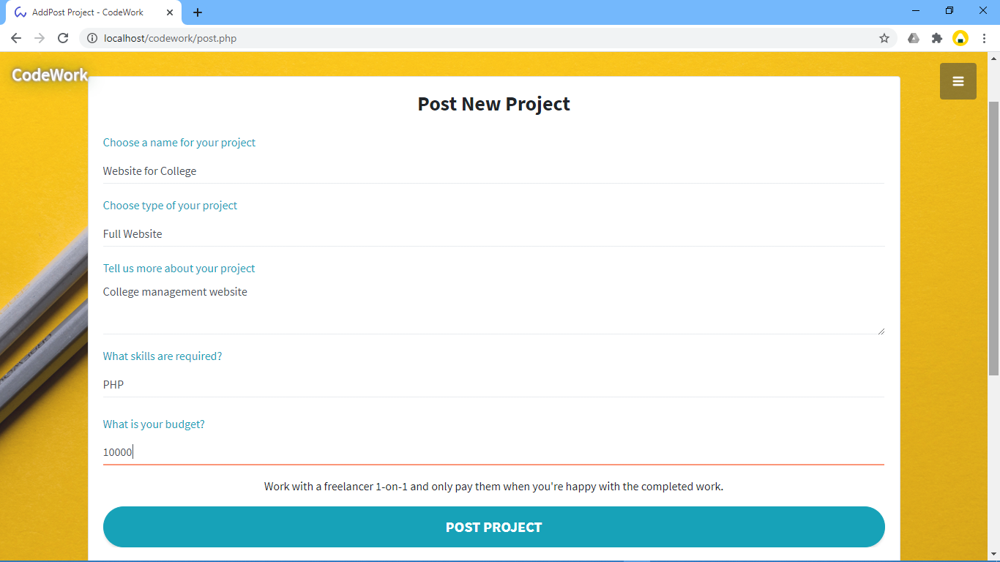
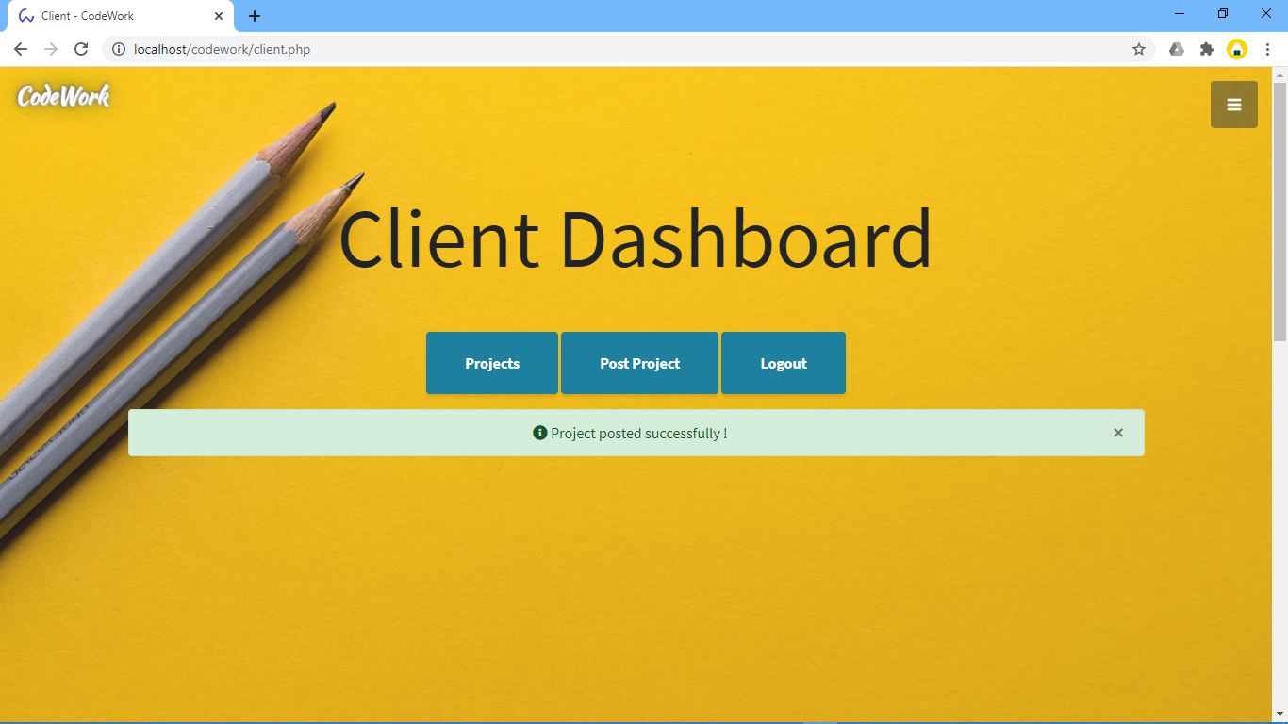
User post product: -
SI NO. | Test case | Expected Result | Test Result
1. | On the click of POST PROJECT button | Add Project | Success

Slide 43
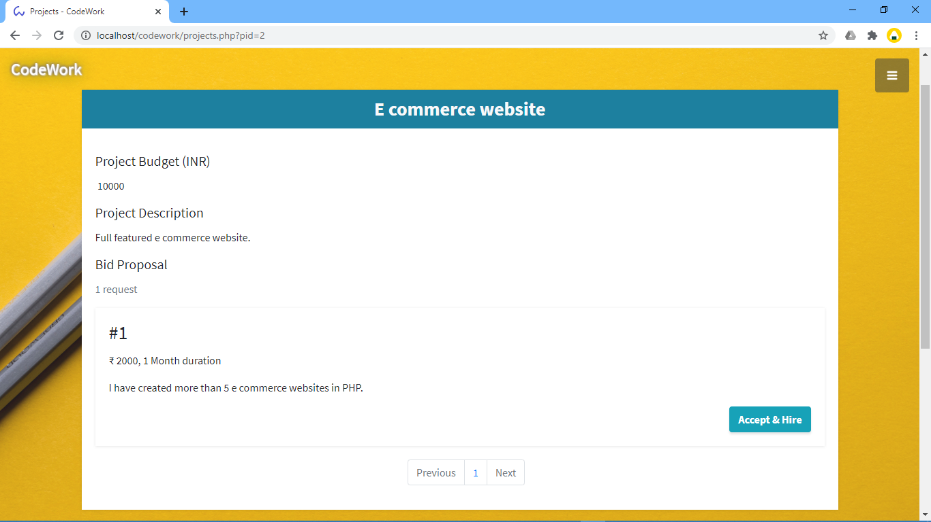
User can view Request for project:
SI NO. | Test case | Expected Result | Test Result
1. | On the click on ALL REQUESTS button | Add Project bidding with bid price and project duration can be seen. | Success

Slide 44
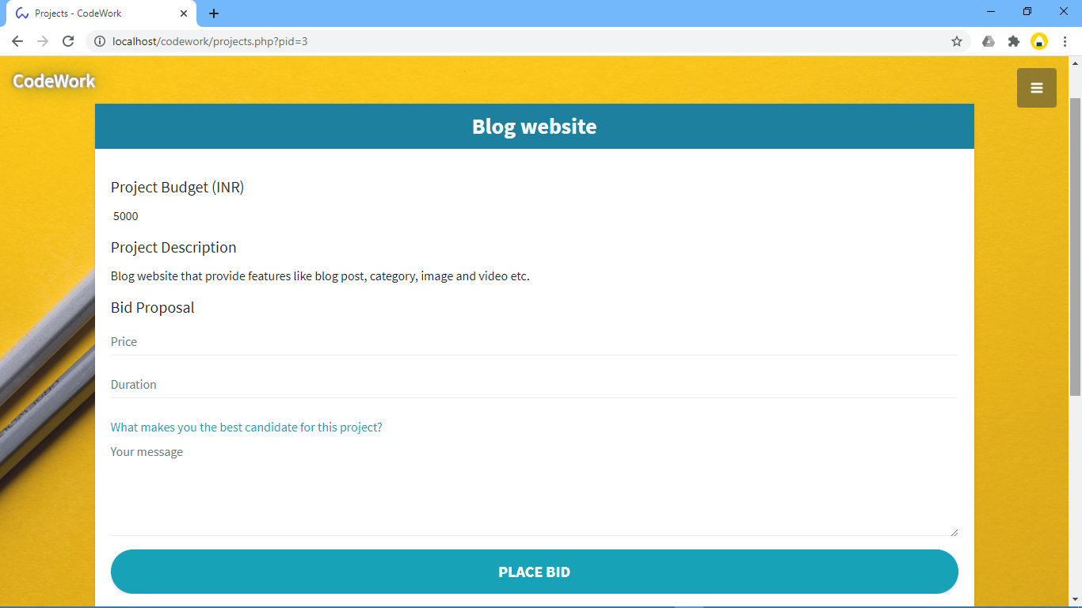
User request for project:
SI NO. | Test case | Expected Result | Test Result
1. | On the click on PLACE BID button | Project bid price, duration and message will be sent. | Success

Slide 45
LIMITATIONS & FUTURE SCOPE
1 Limitations
Limitation of this web site is available in only India.
2 Future Scope
In the future can SMS & Email notification can be implemented in this system.

Slide 46
CONCLUSION
The conclusion is that
The client gets their work easily done.
Clients can choice form lots of well skilled freelancer.
Freelancer get paid on time for their job.
Freelancer can maintain their portfolio and personal details to get more clients project easily.

Slide 47



BIBILIOGRAPHY
https://www.w3school.com/php5
https://getbootstrap.com/docs/4.0/getting-started/introduction
https://github.com/gaurangkumar/codework.git

Slide 48
THANK YOU…

